Slide 1
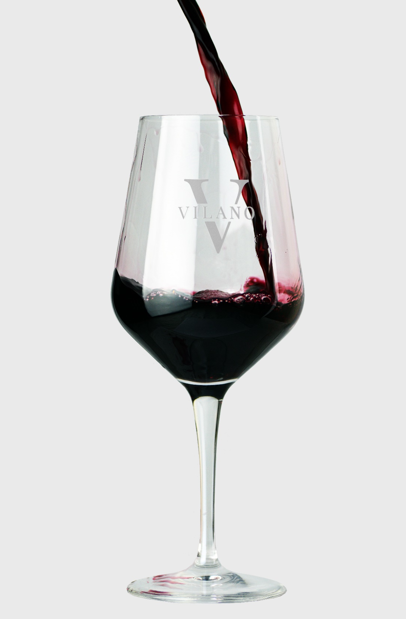


BODEGAS VILANO
SINCE 1957

Slide 2
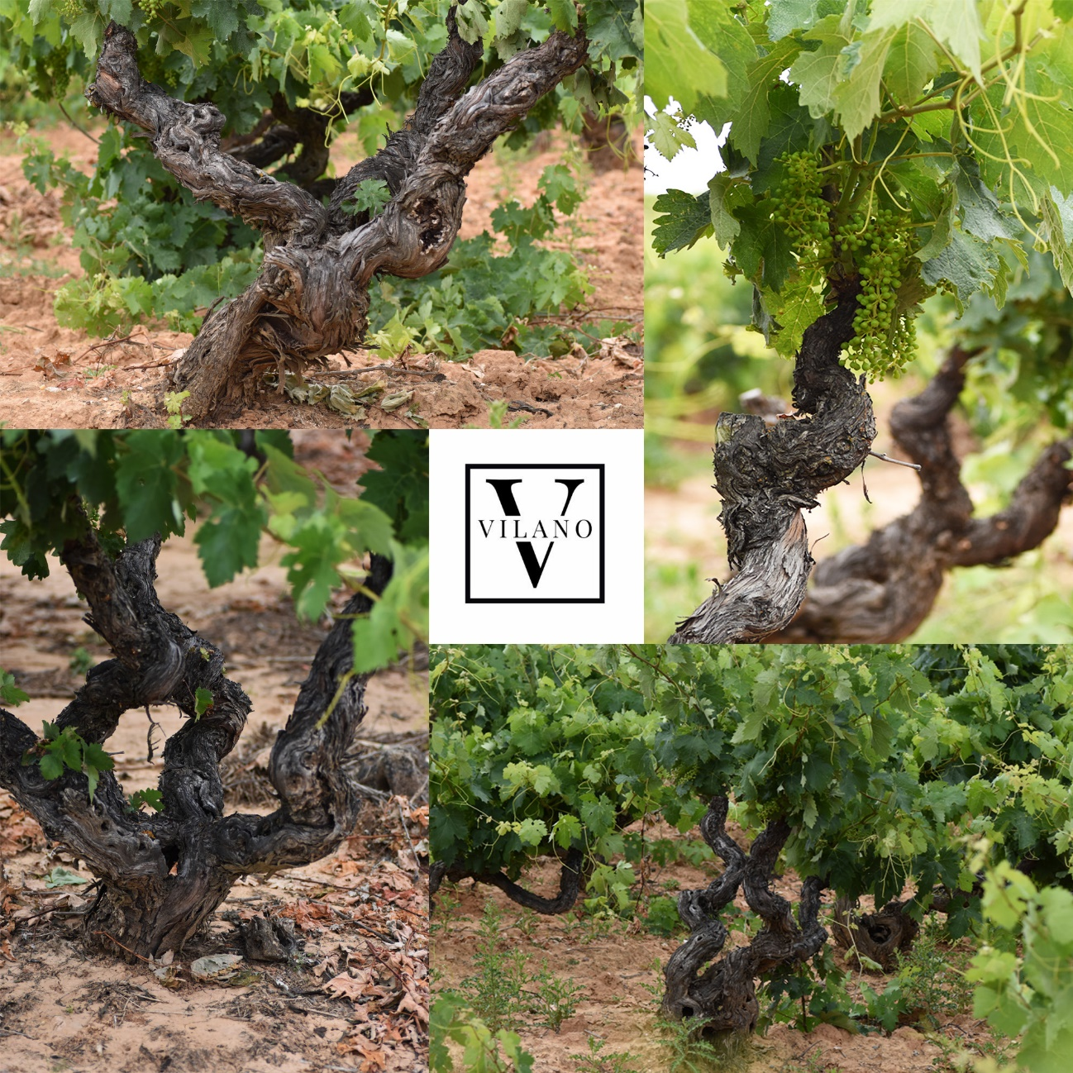
Vine, landscape and people are the starting point for Vilano’s wines. The fruit is harvested and selected by hand by families that have nurtured the vines for three, and even, four generations. This sense of community is the basis of Vilano’s core identity. Founded as a cooperative in 1957 by the parents and grandparents of the current members, Vilano has grown while remaining faithful to two fundamental priorities: continuous improvement and the preservation of the centennial vineyards that shape its wines and heritage.
Having started with a processing capacity of 300,000 kg of grapes, it now processes up to 2.6 million kg, and is planning further expansion, with the belief that the wines of Ribera del Duero have an ever-growing potential among the world’s best. This belief has marked the evolution of the company throughout its half-century of history.

Slide 3
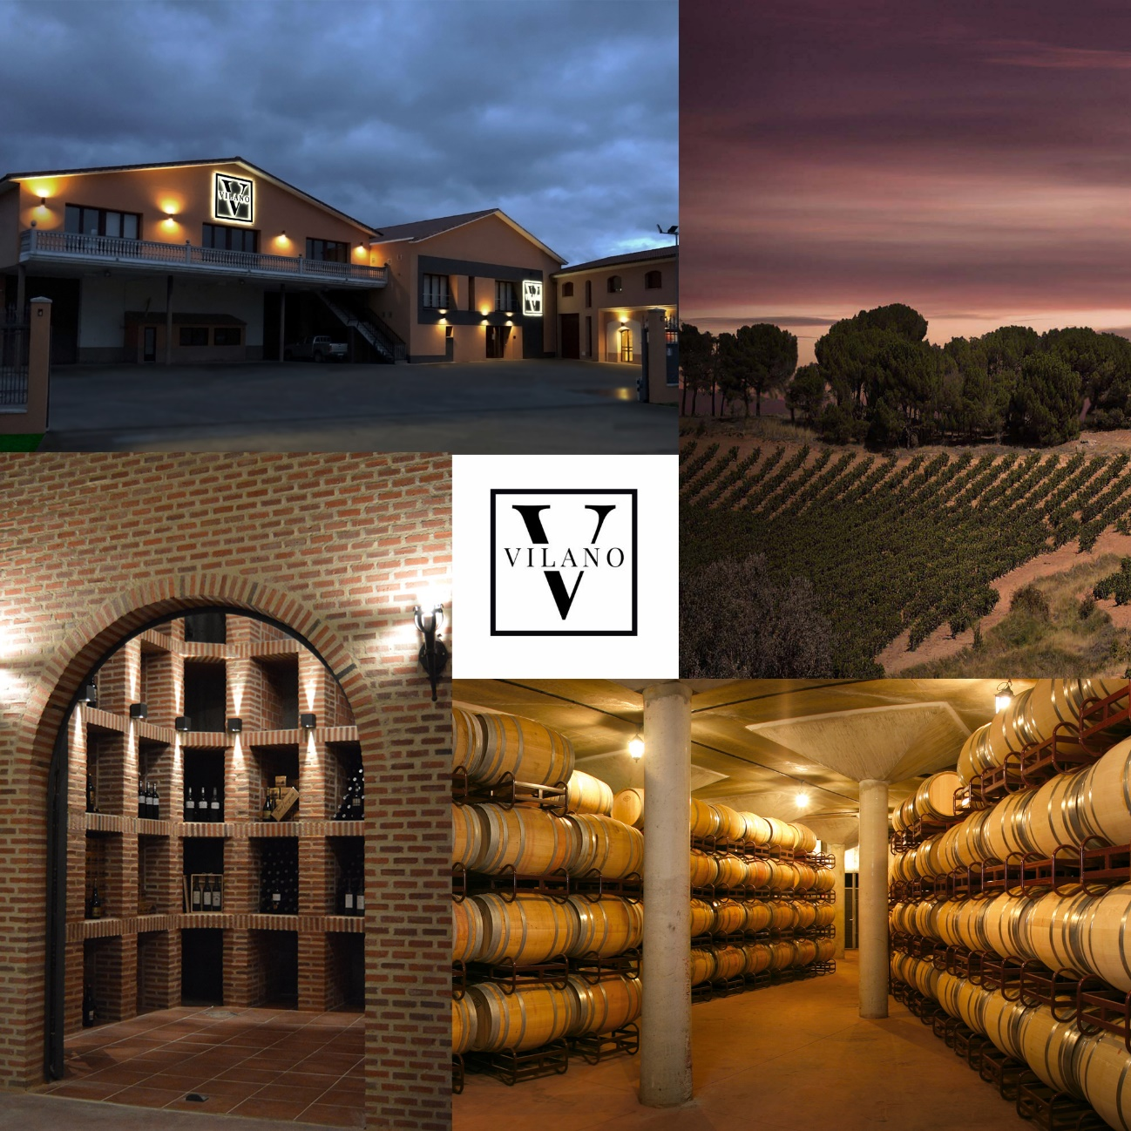
The winery is one of the most historic in Ribera del Duero, founded before it was granted DO status. It has always been committed to both tradition and excellence, as a result of effort, work and, above all, knowledge and passion for the grapes, wines and terroirs of Ribera del Duero. Desiderio Sastre, Vilano’s general manager, has developed the company’s vision and applied overarching innovations which led Vilano to receive excellent ratings from the world’s best critics, as well as numerous international awards.
Vilano’s international presence has grown significantly and its wines can be found in some of the best restaurants the world over. Truth and essence are found inside the bottles; aromas and flavours that leave an indelible mark. Each of Vilano’s wines encapsulate the history of Ribera del Duero, the stories of each grower, and a step towards a modern vision of the region.

Slide 4
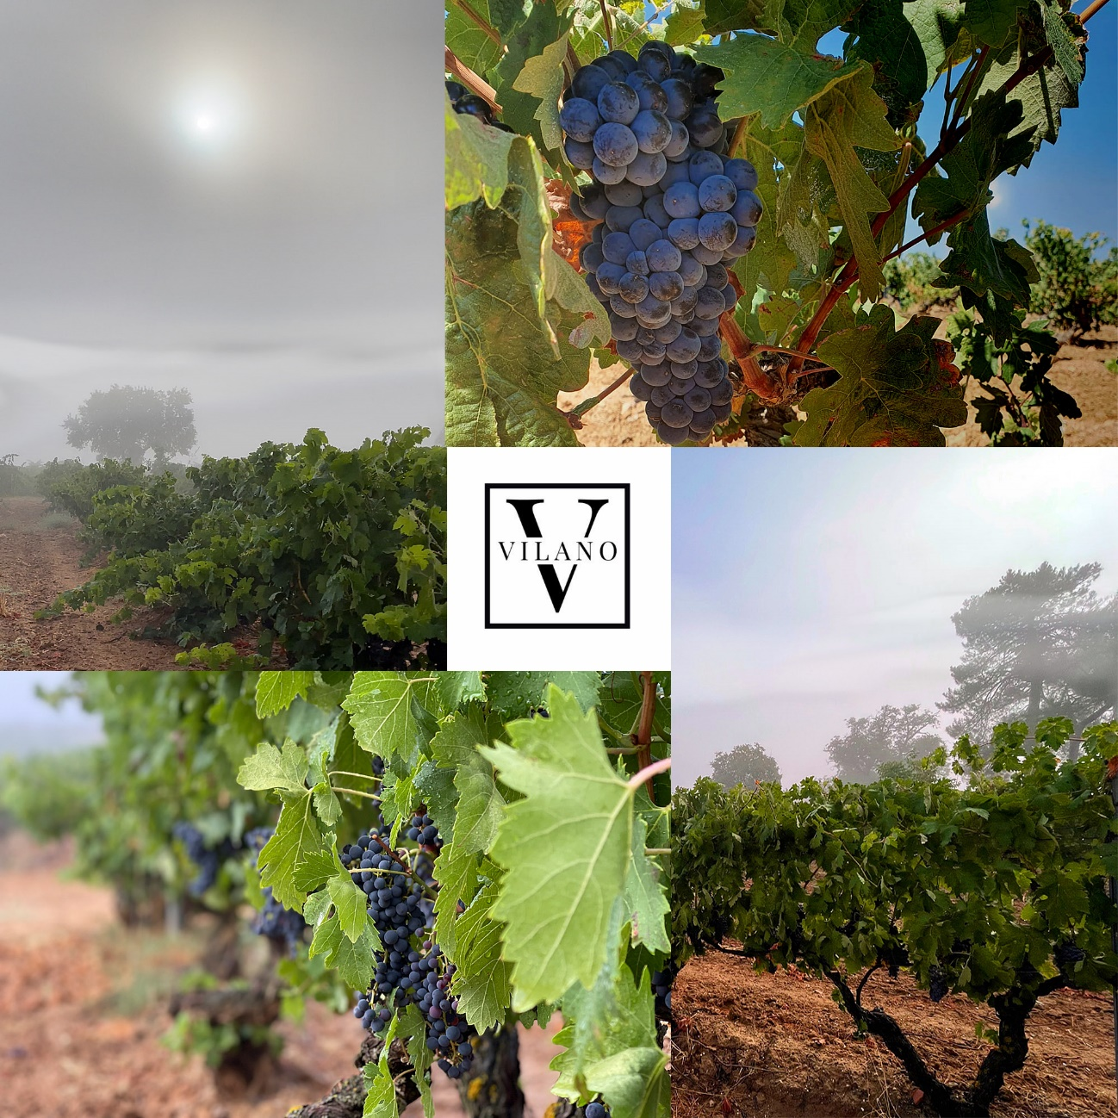
With Tempranillo (Tinto Fino) as the queen variety and inspiration for the whole range, Vilano produces a diverse range that includes a sparkling, a rosado, and seven different reds. These are all fermented in stainless steel, unstemmed and under controlled temperature. After malolactic fermentation has taken place over winter, a preliminary tasting and evaluation of aromatic profile, structure and ageing potential determines which wines will become Crianzas, Reservas or Signature blends.
Each wine will then be aged in selected French, American, central and/or Eastern European oak, with the different origins of the wood contributing with specific aromas and tannins. This is the alchemical process through which the fruit from the 300 hectares of vineyards tended to by Vilano’s members become wines that stand for Ribera del Duero’s tradition and future potential.

Slide 5
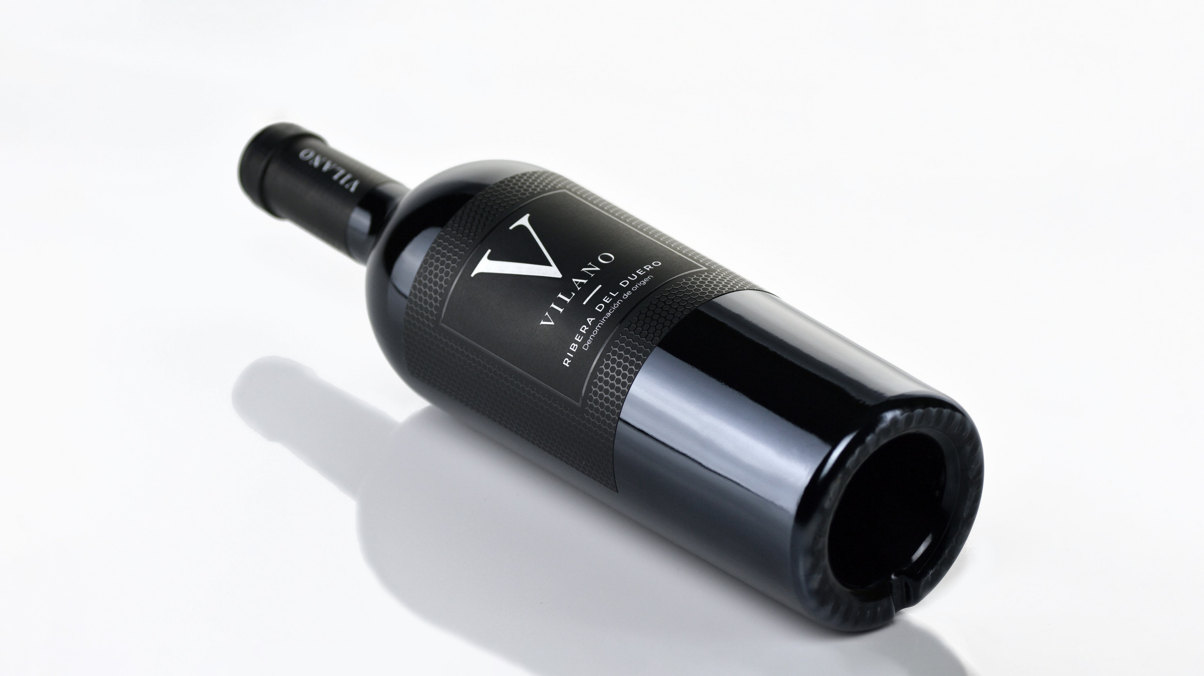



Slide 6

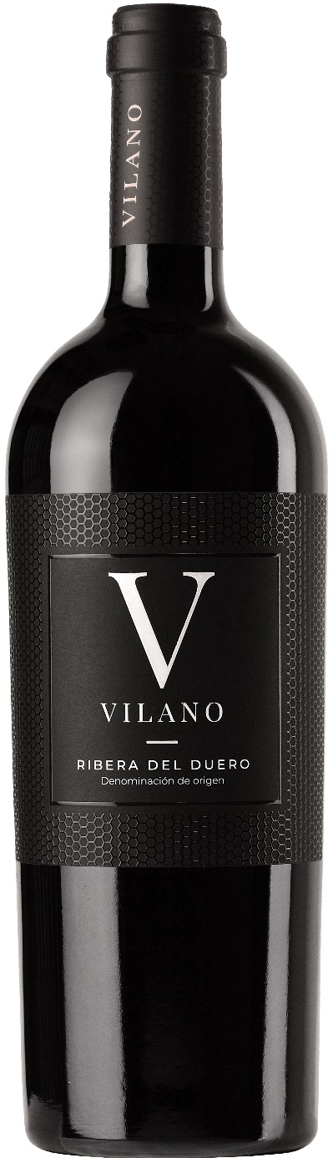
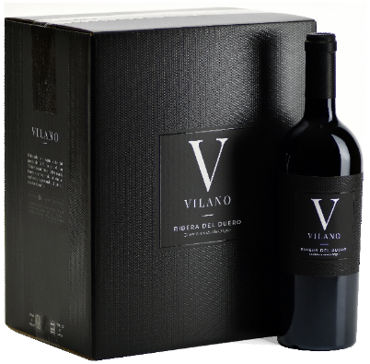
VILANO SINGLE VINEYARD
AWARDS & RATINGS
VINTAGE 2020
94p Andreas Larsson-Tasted
94p Wine Enthusiast
92p James Suckling
93p vvWine.ch
93p Gilbert & Gaillard
VINTAGE 2019
97p Gardini Notes
97p Guía Vivir el Vino
94p Tastings
94p vvWine.ch
94p Raymond Chan Wine Reviews
92p Andreas Larsson-Tasted
92p Gilbert Gaillard
92p Guía Peñín
92p Vertde Vin Magazine
92p WinesCritic.com
VINTAGE 2020
APELLATION: D.O. RIBERA DEL DUERO
GRAPE VARIETY: 100% TINTA FINA
WINE CONCEPT: Sourced from the grapes from the traditional Pago del Vilano located in Pedrosa del Duero, representing the maximal expression of our terroir. This vineyard was planted in 1917 with the purest Tinto fino clone currently found in Ribera del Duero, producing small clusters that transfer to the wine all the character and authenticity of our growing area.
WINEMAKING: It is a 100% Tinta Fina wine with extreme low yield, selected by hand. Malolactic fermentation and aged for 24 months in medium toast French oak barrels. Limited Production: 4.100 bottles. Numbered bottles
TASTING NOTES: Bold berry and black-cherry aromas nicely assembled with oaky nuances like coconut scents. This has yet hard but manageable tannins that create a powerful but elegant mouthfeel. Flavors of coconut, vanilla, blackberry and chocolate finish with firm, dry tannins, fresh acidity and a lasting mocha flavor.
STANDARD PACKAGING
Bottle of 75cl
Cartons of 6 bottles.
95 cartons per Euro pallet

Slide 7
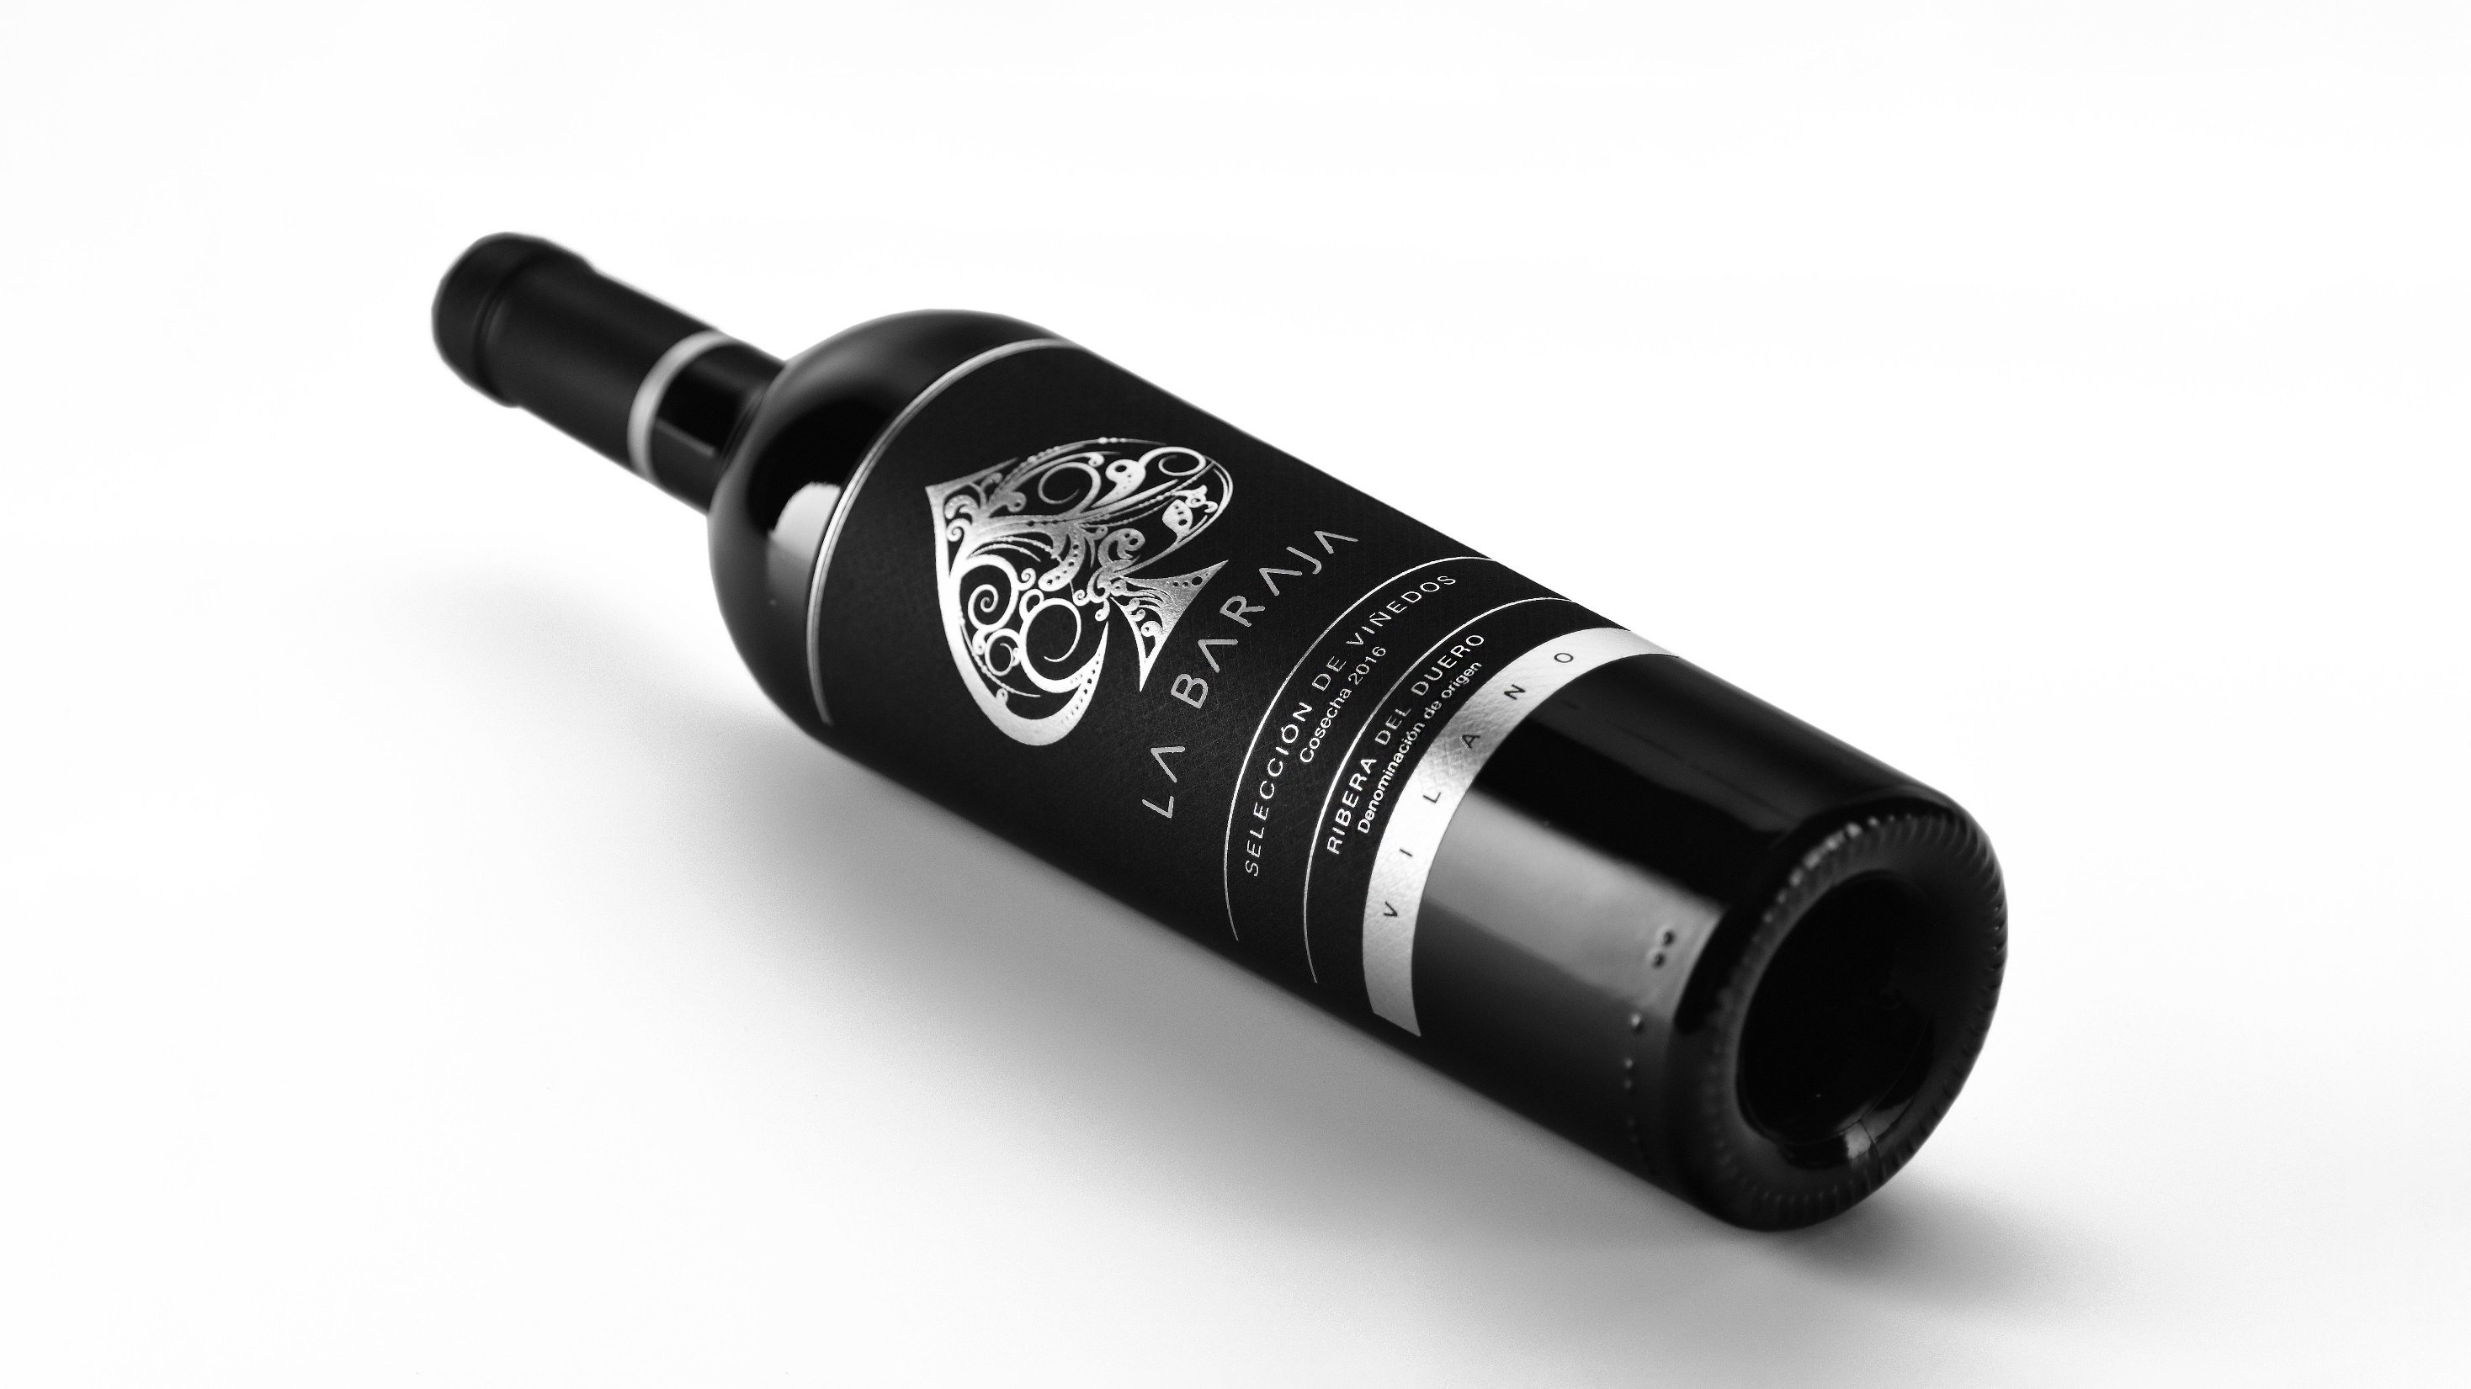
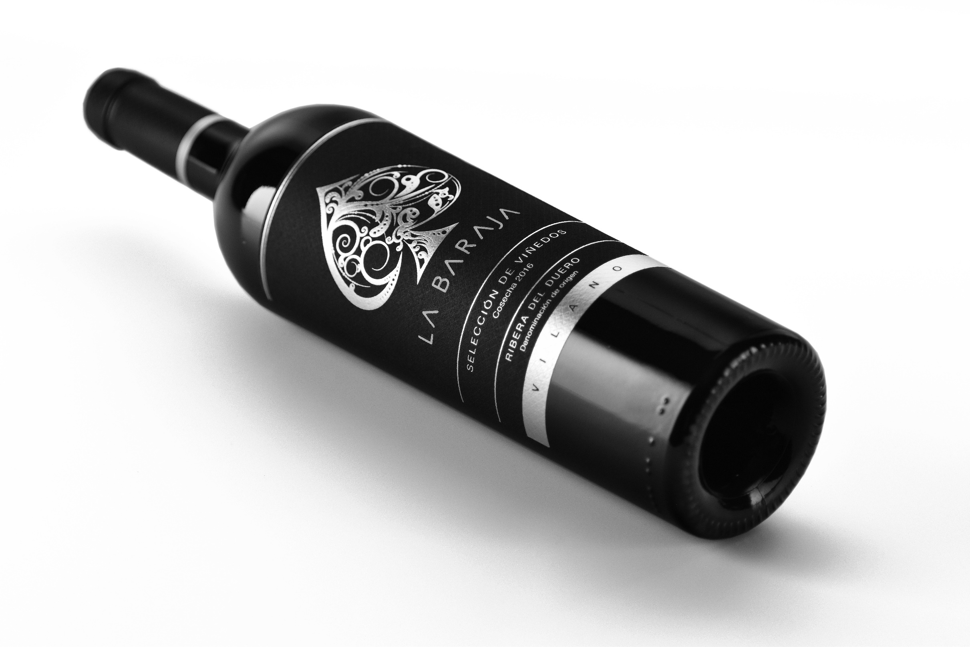

Slide 8
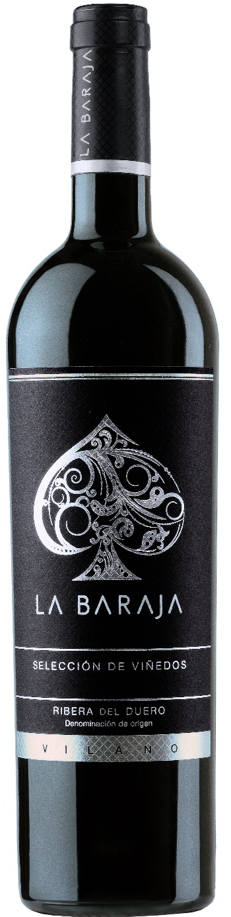
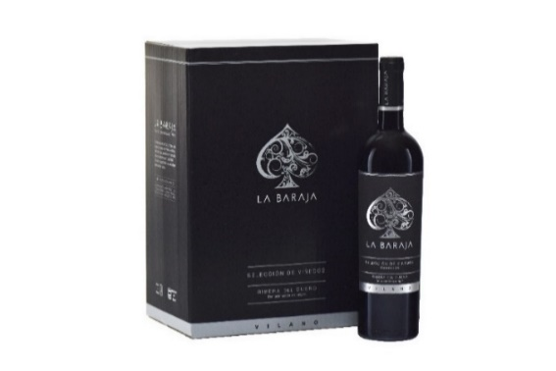
LA BARAJA RED BLEND
AWARDS & RATINGS
VINTAGE 2019
95p Gardini Notes
93p James Suckling
93p Tastings(BevTest)
93p Gilbert Gaillard
93p Andreas Larsson
93p Wine Aling Canadá
92p Wines & Spirits
90p Guía Peñín
90p Vertde Vin Magazine
90p vvWine.ch
VINTAGE 2016
93p Raymond Chan Wine Reviews
92p Gilbert & Gaillard
91p Wine Enthusiast
96p Guía Vivir el Vino
VINTAGE 2015
91p Robert Parker
92p James Suckling
VINTAGE 2019
APELLATION: D.O. RIBERA DEL DUERO
GRAPE VARIETY: 75% TINTA FINA, 15% CABERNET SAUVIGNON, 10% MERLOT
AGING: 18 months in medium toast Frech oak
SERVING TEMPERATURE: 16- 18ºC.
WINE CONCEPT: The blend of Vilano is designed to approach a more international profile by combining the traditional Tinta Fina grapes from our old vines together with Cabernet Sauvignon and Merlot coming from the highlands of the DO Ribera del Duero in an excellent harvest and vintage.
WINEMAKING: Malolactic fermentation and aged for 18 months in medium toast French oak barrels Limited Production: 14.200 bottles. Numbered bottles
TASTING NOTES: Color: Deep ruby red in color. Ripe red fruit, black cherry, black currant and blackberry. Nose: Black pepper, tobacco, licorice, vanilla and violet notes. Taste: Elegant and full bodied wine with ripe tannins and a long, lingering finish.
STANDARD PACKAGING
Bottle size 75cl
Cartons of 6 bottles.
100 cartons per Euro pallet

Slide 9
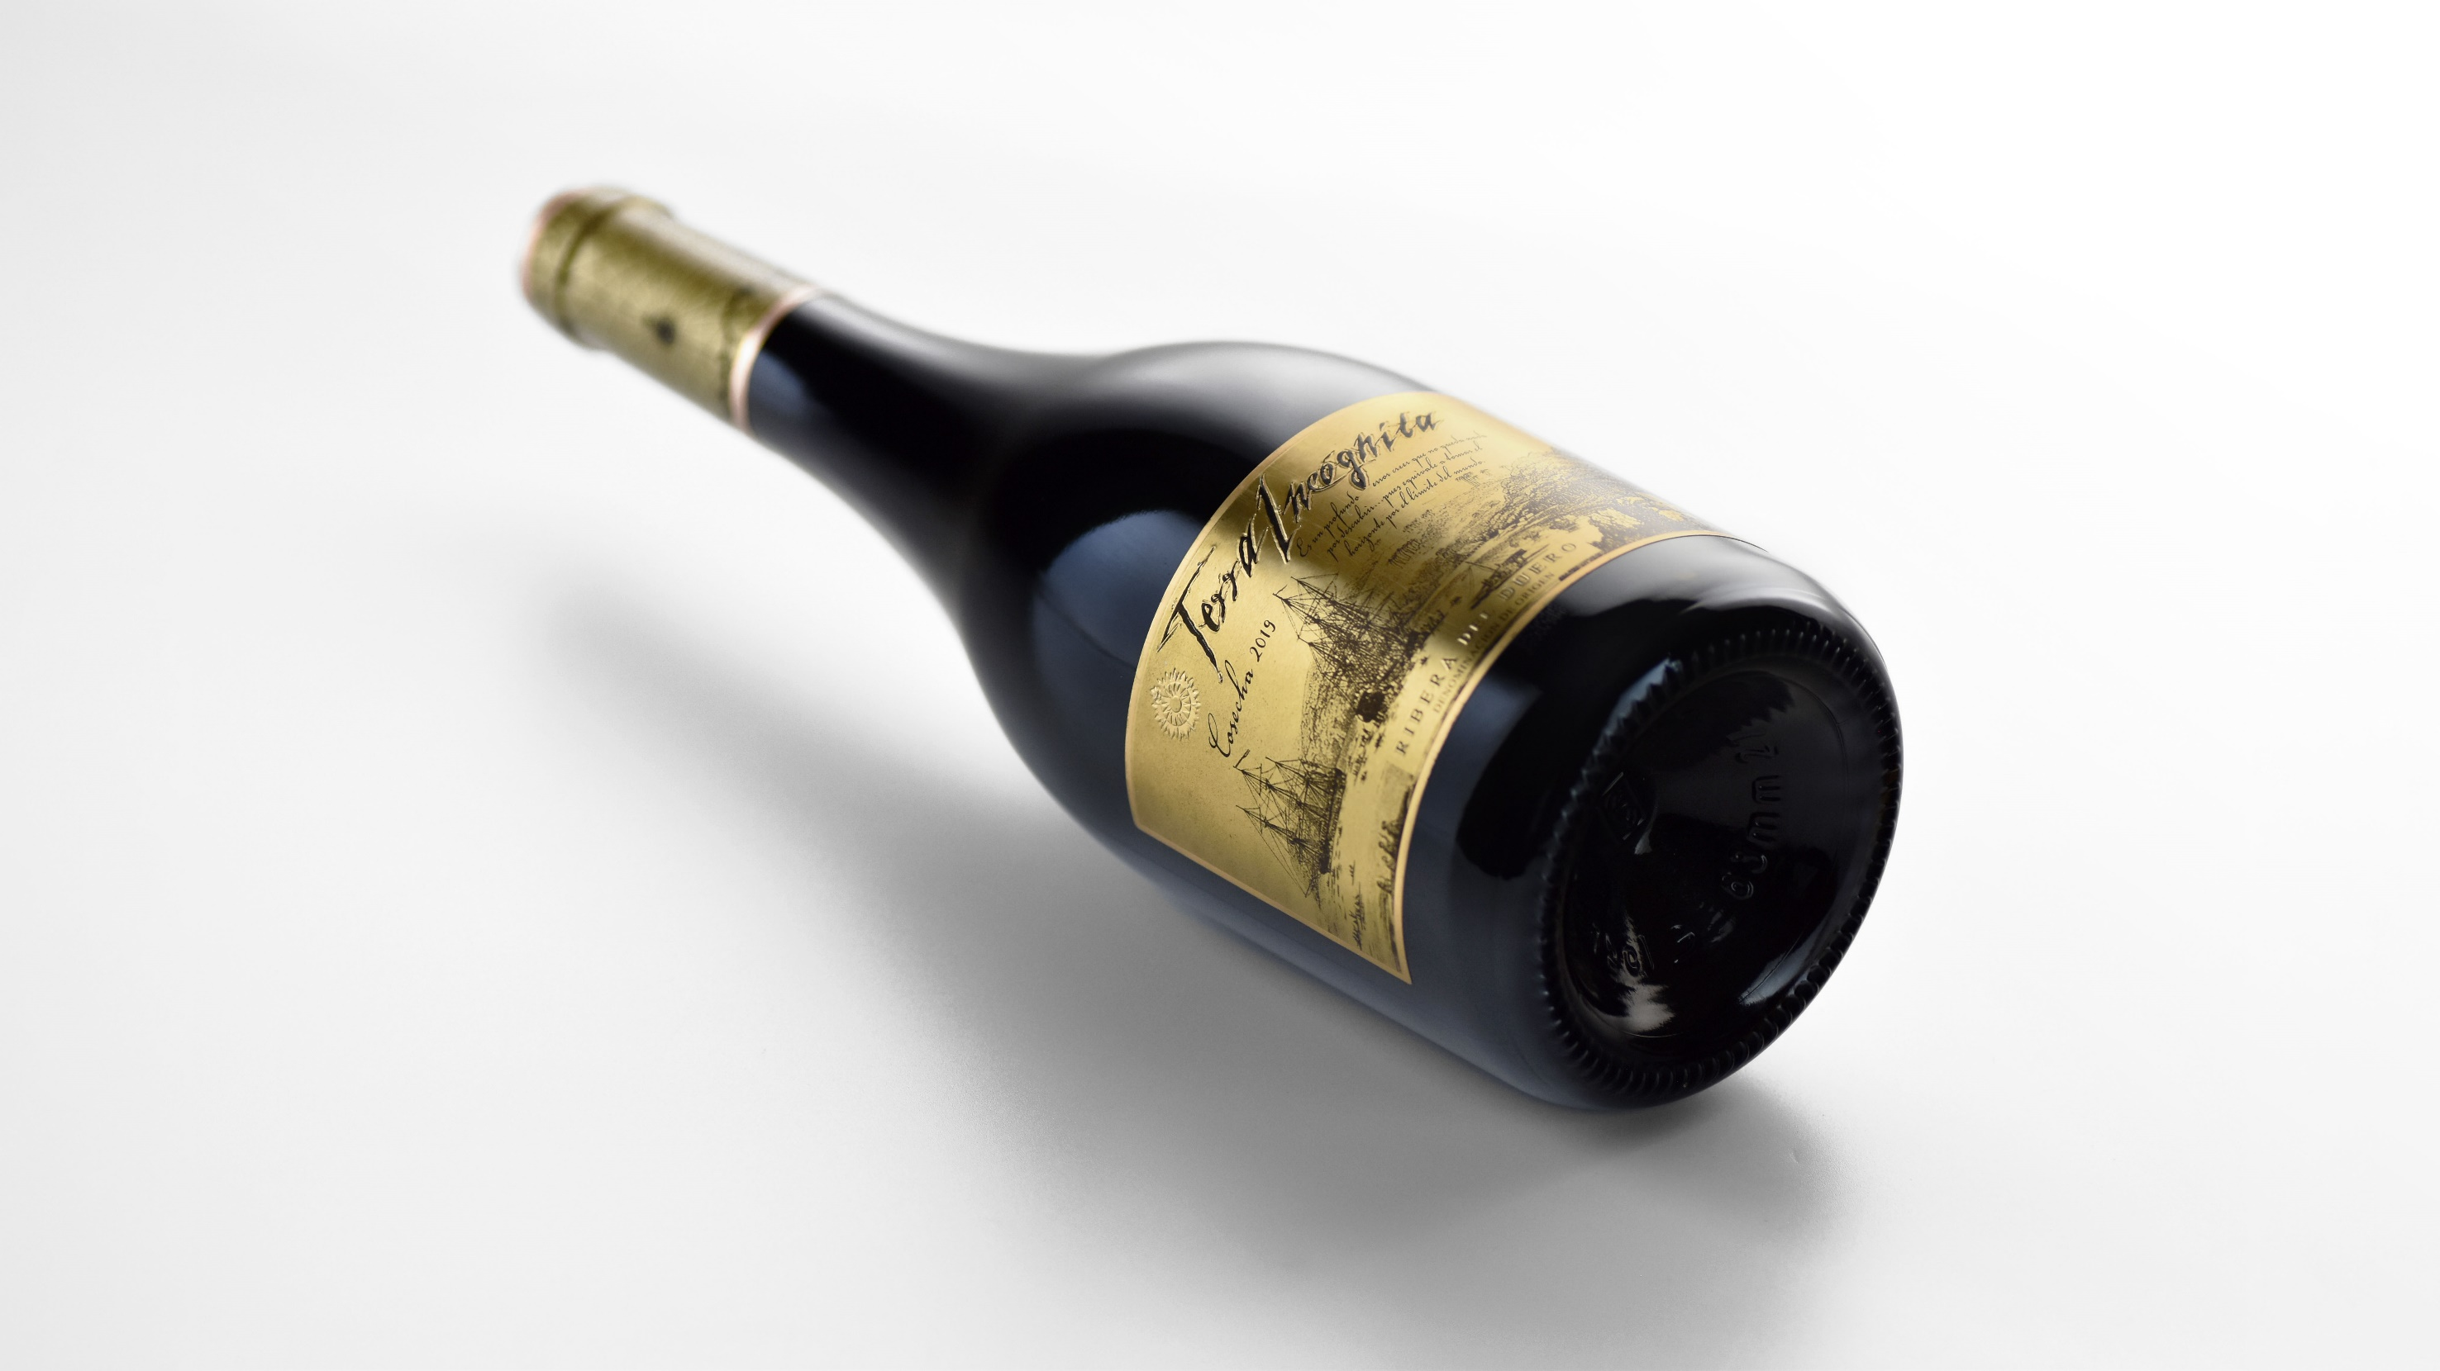

Slide 10
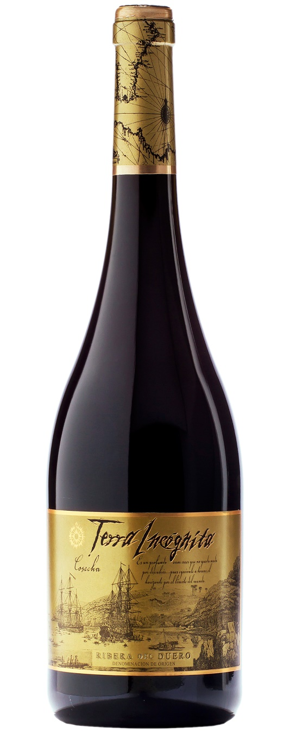
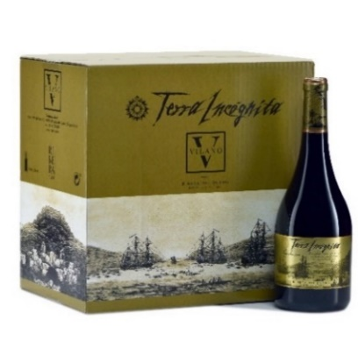
TERRA INCOGNITA OLD VINES
AWARDS & RATINGS
VINTAGE 2020
94p Mikel Huidn
92p James Suckling
93p vvWINE.CH
93p Gardini Notes
92p Gilbert & Gaillard
92p Vertdevin Magazine
90p TASTINGS(Beverage Tasting Institute)
VINTAGE 2019
95p Guía Vivir el Vino
93p Tastings
93p Vertde Vin Magazine
92p Wine & Spirits
92p vvWine.ch
92p Guía Peñín
92p Gilbert Gaillard
91p Wine Aling Canada
91p Raymond Chan Wine Reviews
90p Wines Critic Raffaele Vecchione
90p Andreas Larsson-Tasted
VINTAGE 2019
APELLATION: D.O. RIBERA DEL DUERO
GRAPE VARIETY: 100% TINTA FINA,
SERVING TEMPERATURE: 16- 18ºC.
WINEMAKING: Handpicked harvest of centenary vineyards. Fermentation in small stainless steel tanks and malolactic fermentation in new French oak barrels. Aged for 22 months in French oak barrels and 12 months in the bottle.
TASTING NOTES: Ripe red cherry color with garnet-colored rim, dense and opaque. Intense on the nose, exhibits a nice bouquet of candied black fruits and spices like star anise, clove and vanilla blended with slightly toasted nuances from its ageing in oak barrels. Lovely in the mouth, meaty and yummy with velvety and sweet tannins, long finish. The most representative expression of the truly character of Ribera de Duero wines. Wide drinking window.
STANDARD PACKAGING
Bottle size 75cl
Cartons of 6 bottles.
70 cartons per Euro pallet

Slide 11
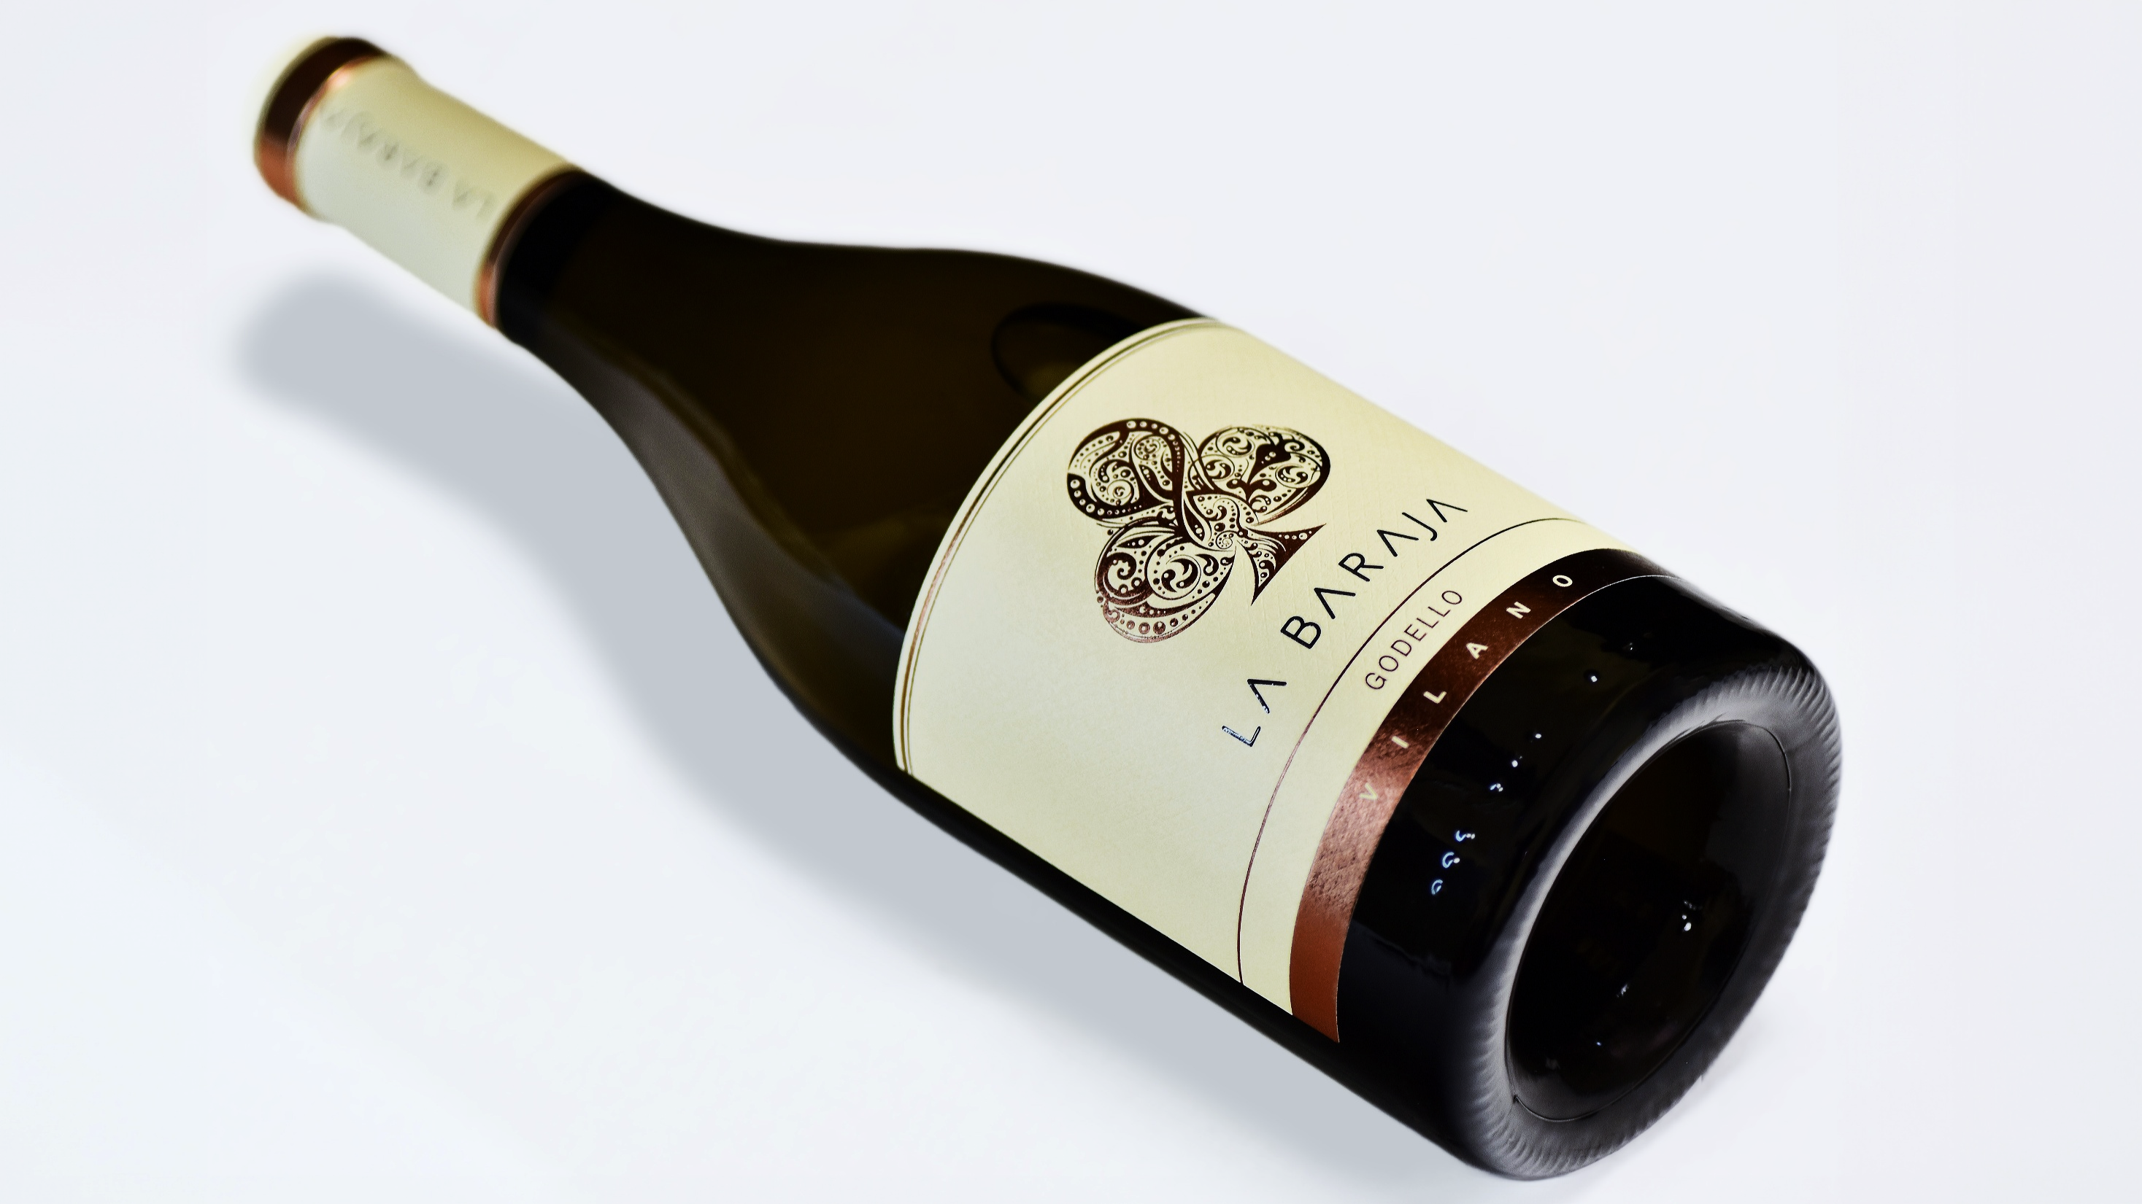


Slide 12
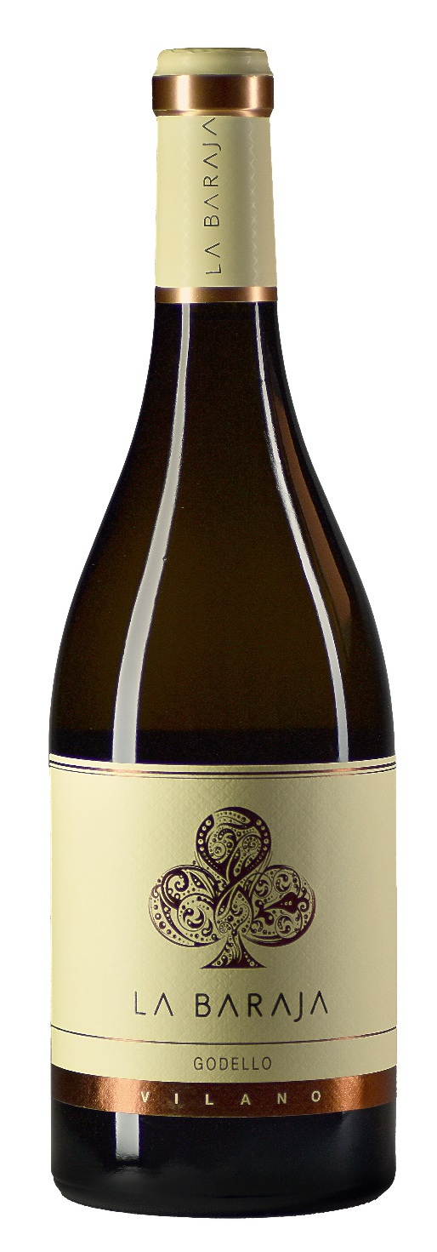
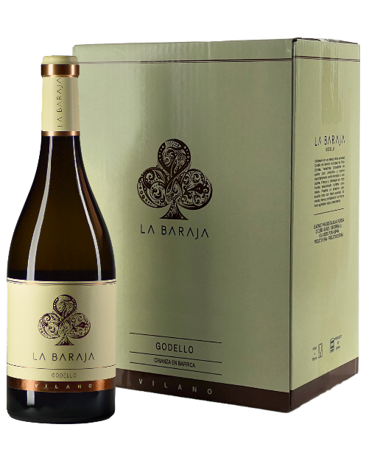
LA BARAJA GODELLO
AWARDS & RATINGS
VINTAGE 2021
93p Beverage Testing Institute
93p Raymond Chan Wine Reviews
93p Raffaele Vecchione
92p Gilbert & Gaillard
90p Andreas Larsson-Tasted
VINTAGE 2020
94p Gardini Notes
VINTAGE 2022
APELLATION: D.O VALDEORRAS
GRAPE VARIETY: 100% GODELLO
WINEMAKING: Made with the most select grapes of the Godello variety from the municipality of Entoma (Orense, Valdeorras), from shallow and poor soils, mostly clay-ferrous and with slate.
TASTING NOTES:This is an elegant and full-bodied aging and battonage, aged for five months in French oak barrels from selected cooperages that give it a unique character and taste on the palate. It has an attractive lemon yellow colour with a steely rim. It is creamy, intense, pure and complex with a long and persistent finish that you never want to end. Perfect for meat and fish.
STANDARD PACKAGING
Bottle of 75cl
Cartons of 6 bottles.
84 cartons per Euro pallet

Slide 13
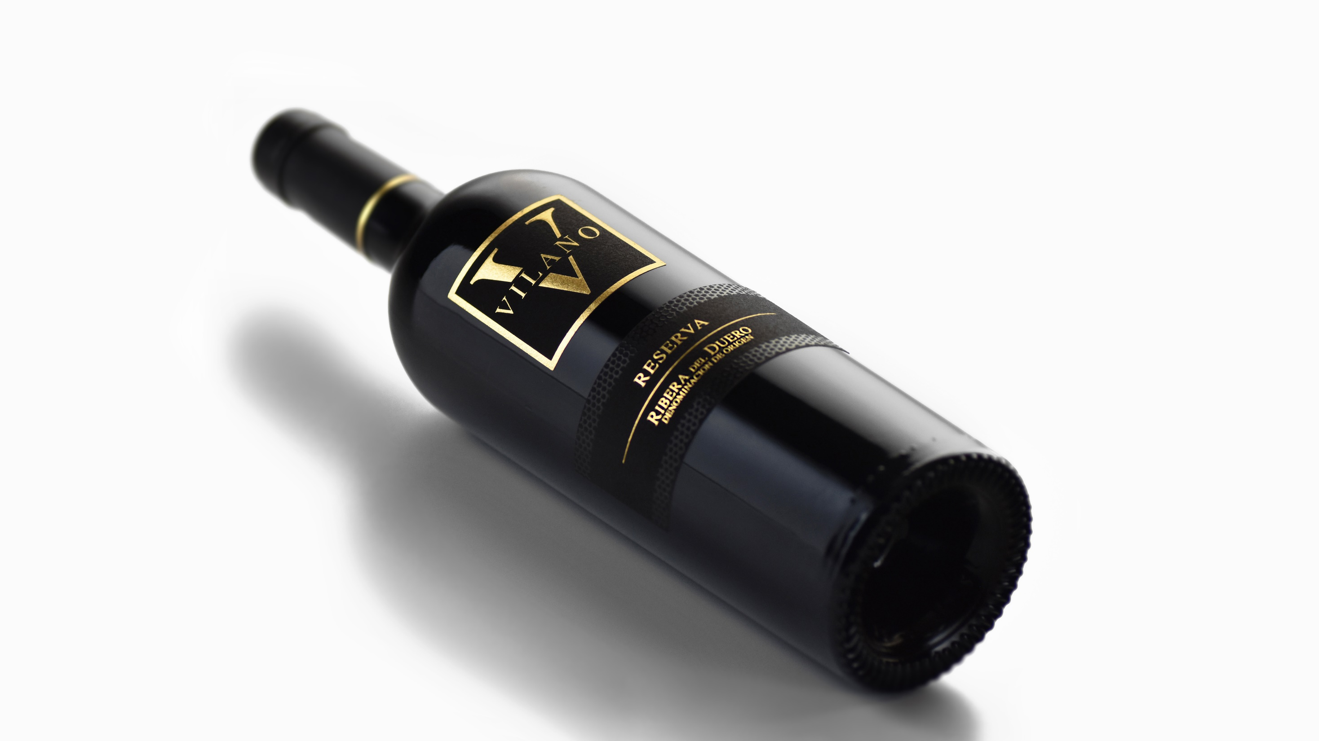

Slide 14
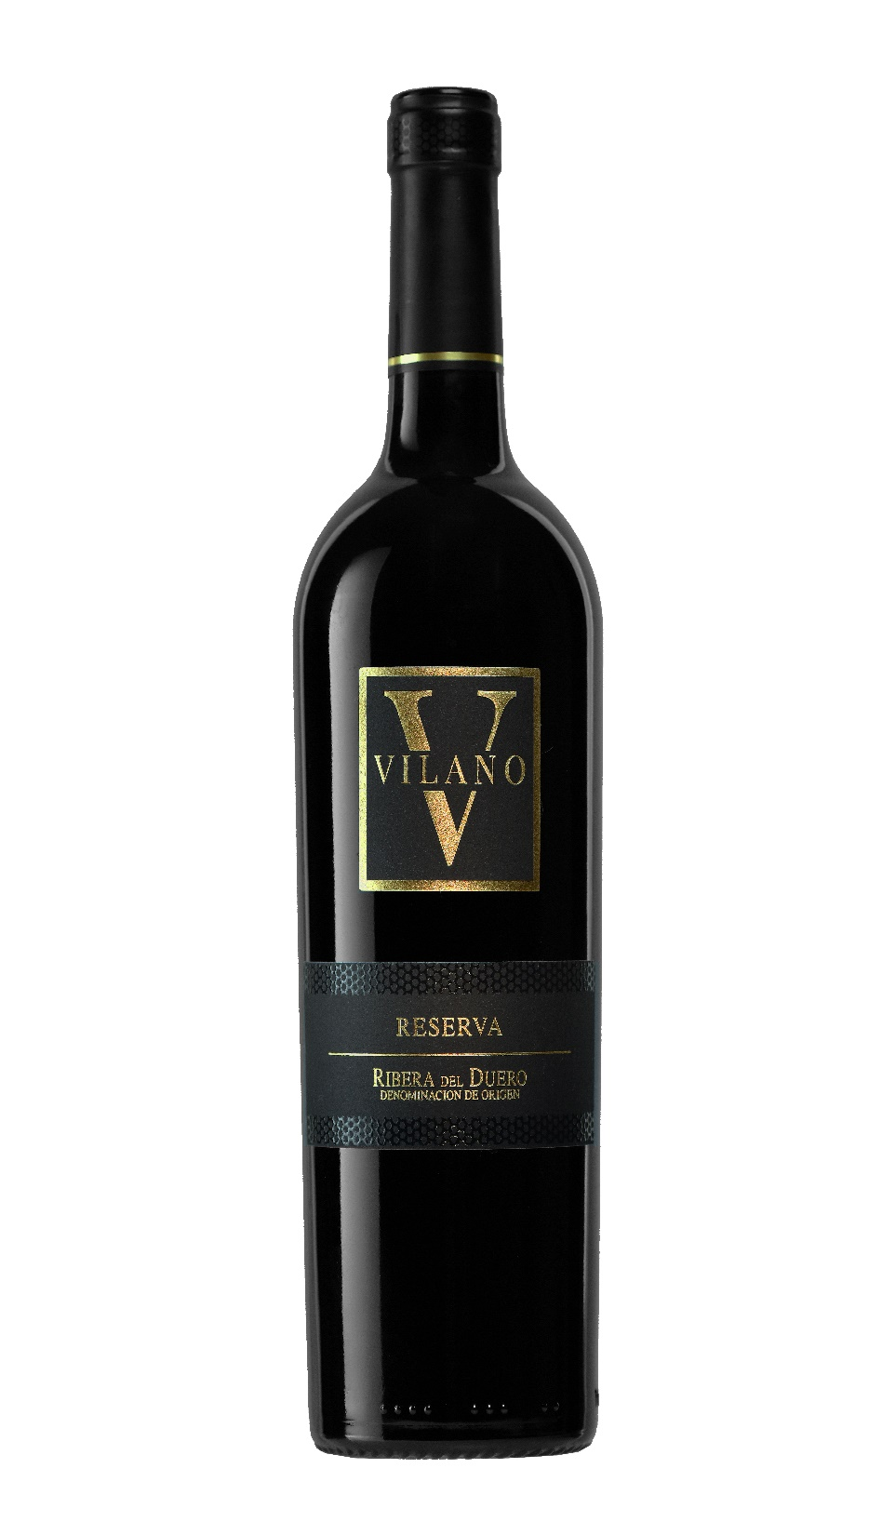
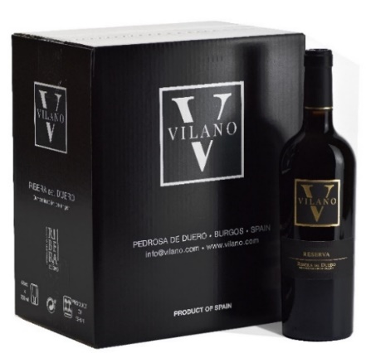
VILANO RESERVA
AWARDS & RATINGS
VINTAGE 2020
92p VVwine.ch
VINTAGE 2019
95p Wine Enthusiast
92p Wine & Spirits
92p Gilebert & Gaillard
93+ p Miquel Hudin
Gold Medal-Bob Campbell-The Real Review
90p Tastings(Beverage Tasting Institute)
VINTAGE 2018
93p Tastings
92p Gilabert & Gaillard
90p Guía Peñín
Gold Medal Sélections Mondiales des Vins
VINTAGE 2019
APELLATION: D.O. RIBERA DEL DUERO
GRAPE VARIETY: 100% TINTA FINA
WINEMAKING: Carefully selected bush vines, older than 50 years from Pedrosa de Duero located at 800 m. high and planted over very poor soils, ideal for vine-growing. Carefully crafted, alcoholic fermentation takes place at controlled temperature of 28 ºC and maceration for 14 more days. Aged for 18 months in French and Central Europe and 18 months of ageing in the bottle.
TASTING NOTES: Deep, bright ruby red. Highly complex, aromatic nose. Flavourful, and yummy with a silky texture and gentle sweet tannins. Vibrant blackcurrant and cherry compote flavours and a hint of vanilla. Persistent finish, leaving dark chocolate and allspice notes.
STANDARD PACKAGING
Bottle of 75cl
Cartons of 6 bottles.
105 cartons per Euro pallet

Slide 15
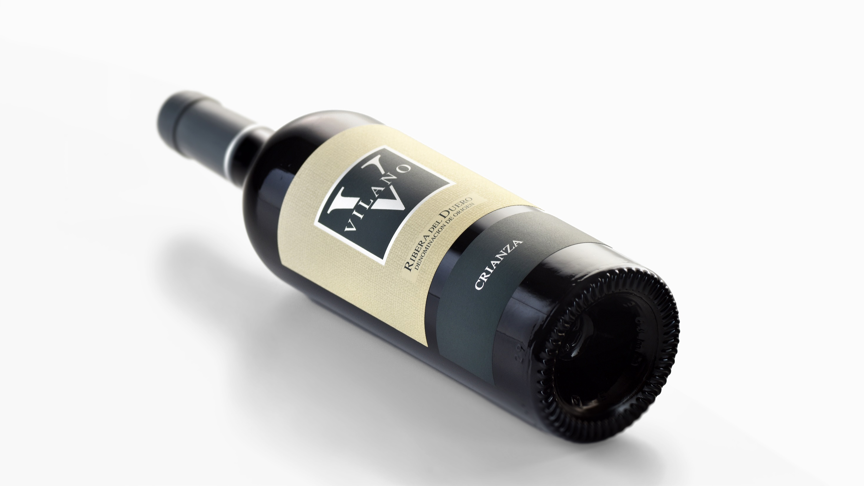

Slide 16
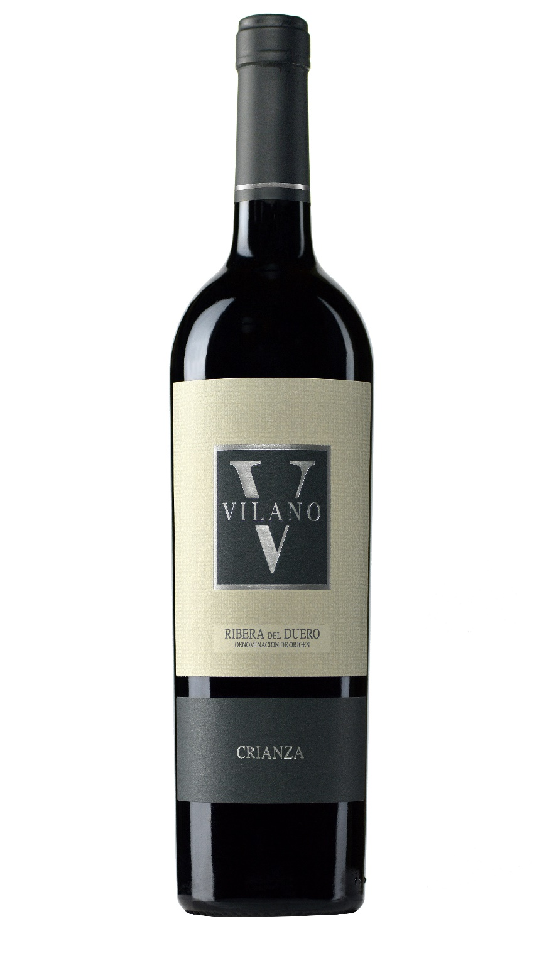
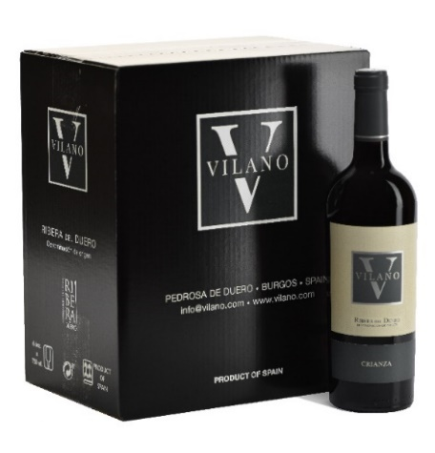
VILANO CRIANZA
AWARDS & RATINGS
VINTAGE 2020
91p James Suckling
92p Wine Enthusiast
90p International Wine Challenge
93p Tastings
92p Andreas Larsson-Tasted
91p Wine & Spirits
90p Gilbert & Gaillard
VINTAGE 2019
90p Win Aling Canada
Gold Medal Gilbert & Gaillard
90p Wine Enthusiast
92p Wine & Spirits
94p Tastings
93p Guía Vivir el Vino
Gold Medal Gilbert & Gaillard
VINTAGE 2020
APELLATION: D.O. RIBERA DEL DUERO
GRAPE VARIETY: 100% TINTA FINA
WINEMAKING: Vine selection of our vineyards, older than 25 years and harvested at their peak of ripeness and located in Pedrosa de Duero. Carefully crafted, alcoholic fermentation takes place at controlled temperature of 28 ºC and maceration for 14 more days. Ageing in American and French oak barrel for 12 months. 3 months of aging in the bottle before release to the market.
TASTING NOTES: Garnet red color with very bright, intense and deep ruby red hues, maintaining the gleam of youth. Balanced and powerful aromas of ripe red fruit and clean wood that enhance the wine. It shows expressive tannins, notable structure and excellent body. Wide drinking window.
STANDARD PACKAGING
Bottle of 75cl
Cartons of 6 bottles.
105 cartons per Euro pallet

Slide 17
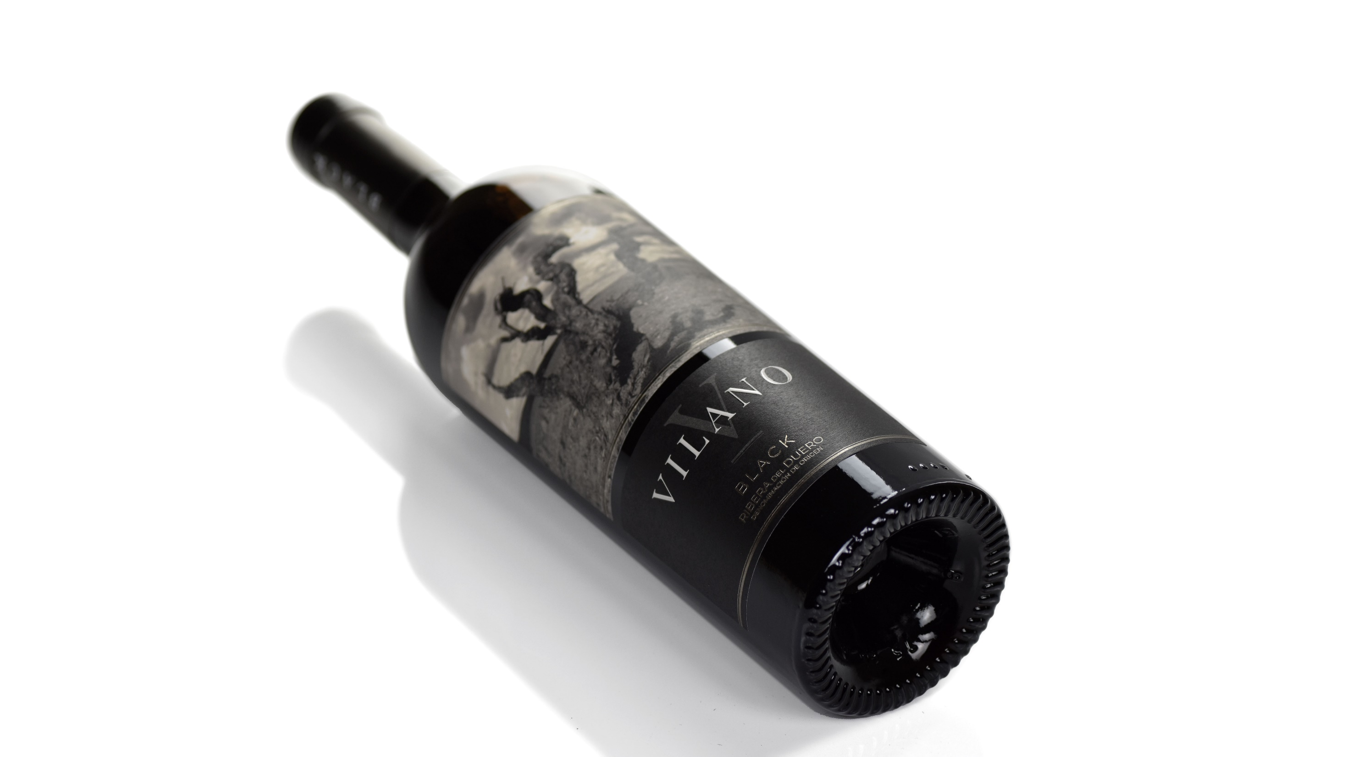

Slide 18
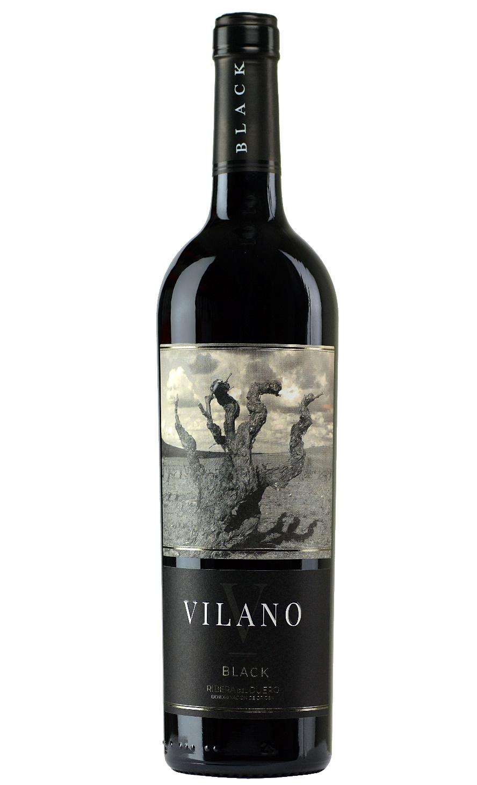
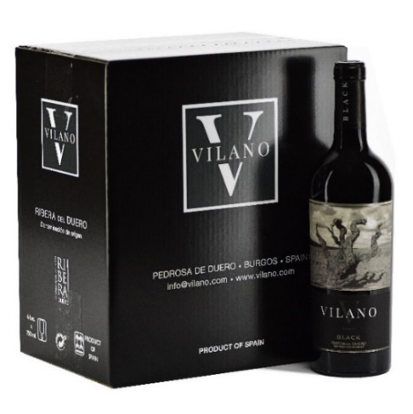
VILANO BLACK
AWARDS & RATINGS
VINTAGE 2021
92p Tastings
90p Gilbert & Gaillard
90p Vertdevin Magazine
90p International Wine Challenge
VINTAGE 2020
Gold Medal Gilbert & Gaillard
93p Tastings
92p Guía Vivir el Vino
90p Wine Enthusiast
89p Wine Spectator
VINTAGE 2019
89p Decanter
VINTAGE 2018
91p Guía Vivir el Vino
91p Wine & Spirits
VINTAGE 2021
APELLATION: D.O. RIBERA DEL DUERO
GRAPE VARIETY: 100% TINTA FINA
WINEMAKING: Selection of the best old vines sourced from 4 plots and older than 50 years. Maceration for 8 to 10 days in stainless steel tanks at a controlled temperature of 25-28 º. Ageing for 8 months in French oak barrels and 3 months in the bottle.
TASTING NOTES: aromas tands out for its deep, inky garnet color, balanced and integrated of black berries, spices and balsamics. A round mouthfeel, well structured, with a long an tasty finish.
SERVING TEMPERATURE: 14º - 16ºC.
STANDARD PACKAGING
Bottle of 75cl
Cartons of 6 bottles.
105 cartons per Euro pallet

Slide 19
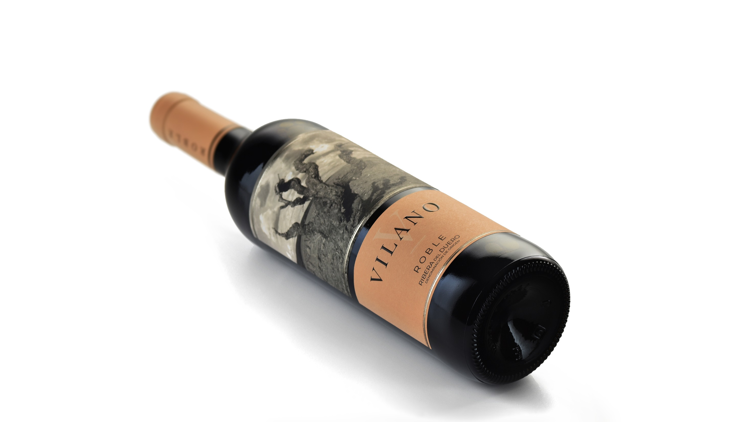

Slide 20
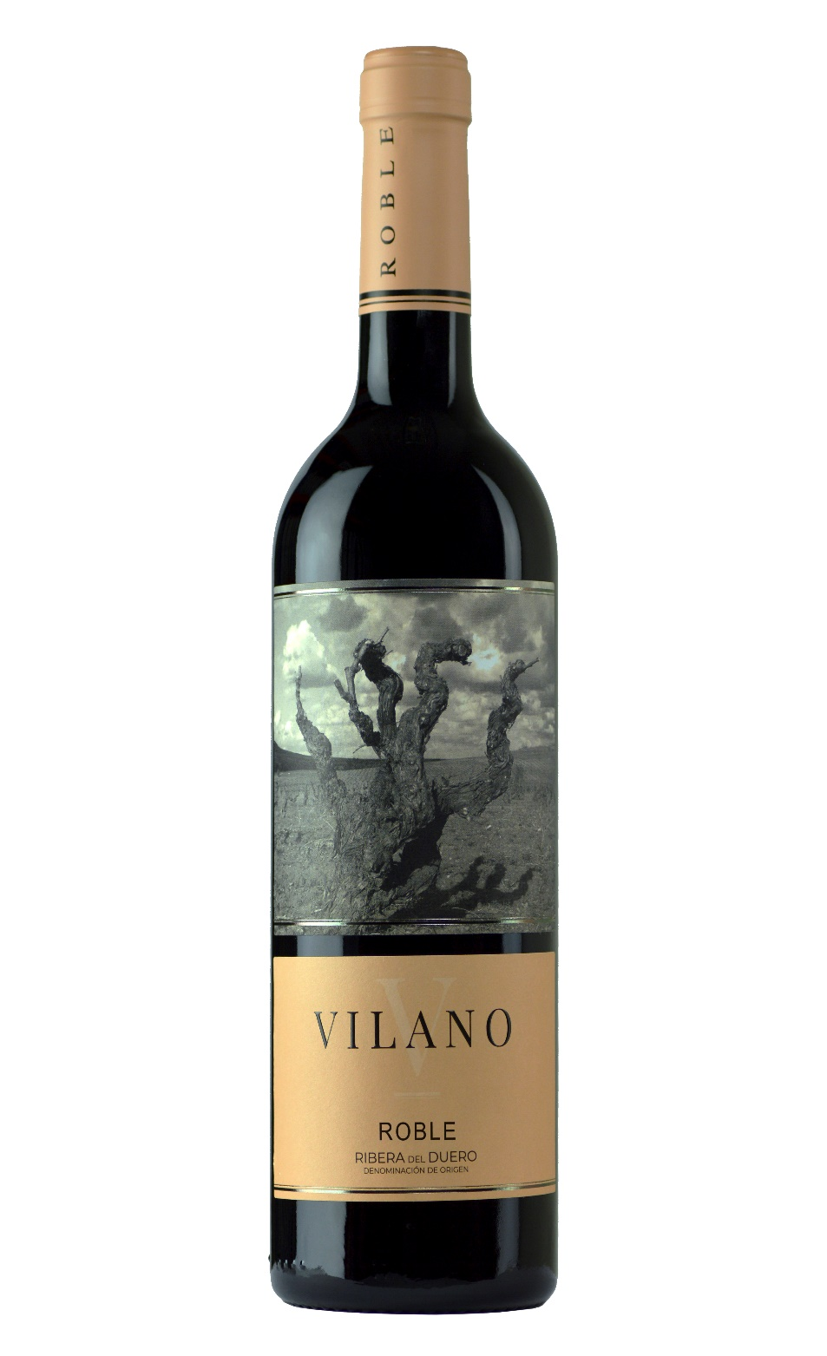
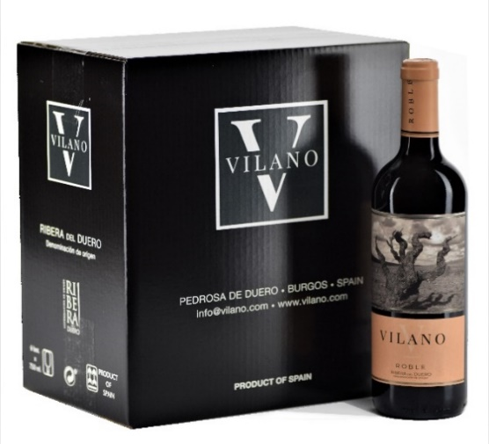
VILANO ROBLE
AWARDS & RATINGS
VINTAGE 2022
93p Tastings
91p Andreas Larsson-Tasted
Gold Medal Gilbert & Gaillard
89p Miquel Hudin
VINTAGE 2021
91p Wine&Spirits
Gold Medal Gilbert & Gillard
90p Decanter
VINTAGE 2020
Gold Medal Gilbert & Gillard
VINTAGE 2018
90p James Suckling
VINTAGE 2017
90p James Suckling
VINTAGE 2022
APELLATION: D.O. RIBERA DEL DUERO
GRAPE VARIETY: 100% TINTA FINA
WINEMAKING: Selection of our vines older than 10 years handpicked at the peak of ripeness and sourced from Pedrosa de Duero. Maceration in stainless steel for 8-10 days at a controlled temperature of 25-28 ºC. Aged for 3 months in American oak barrel and 3 months in the bottle.
TASTING NOTES:
Red cherry with a ruby rim, and medium-to-high intensity. Floral notes, aromas of ripe wood berries and hints of vanilla and liquorice. Rounded, structured and persistent in the mouth. Very harmonic wine.
SERVING TEMPERATURE: 14º - 16ºC.
STANDARD PACKAGING
Bottle of 75cl
Cartons of 6 bottles.
125 cartons per Euro pallet

Slide 21
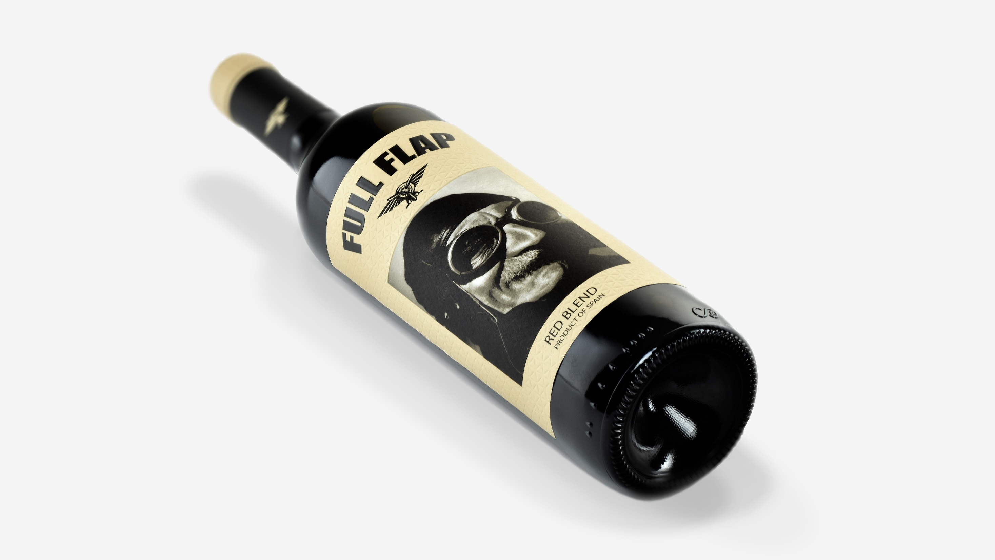

Slide 22
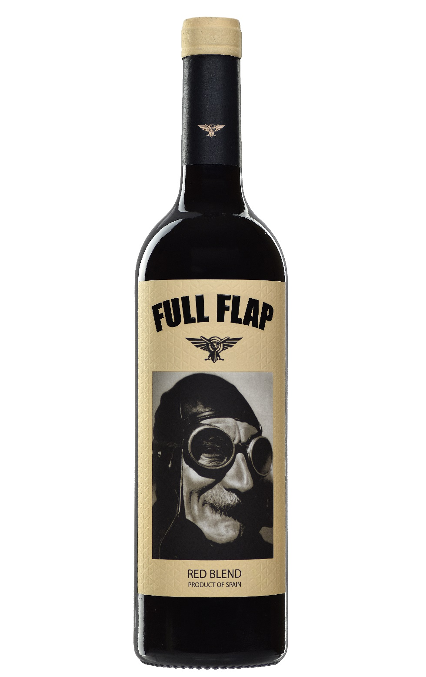
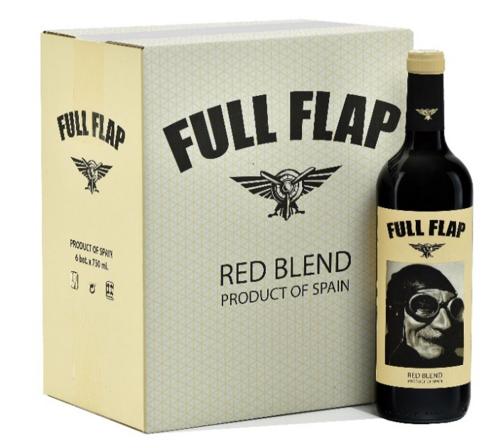
FULL FLAP RED BLEND
AWARDS & RATINGS
VINTAGE 2021
93p Beverage Testing Institute
Gold Medal Gilbert & Gillard
GRAPE VARIETY: 40% Tempranillo 40% Merlot 20% Cabernet Sauvignon
WINEMAKING: Blend of three varieties made separately in stainless steel tanks. Aged for three months in medium toasted French oak barrels.
TASTING NOTES: Upper middle layer with violet rims. High aromatic intensity with berries, soft notes of vanilla and sweet pastry tones. On the palate, wide, long, sweet, silky tannins, persistent with meatiness and freshness, candied red fruits in the retronasal route.
SERVING TEMPERATURE: 14º - 16ºC.
STANDARD PACKAGING
Bottle of 75cl
Cartons of 6 bottles.
125 cartons per Euro pallet

Slide 23
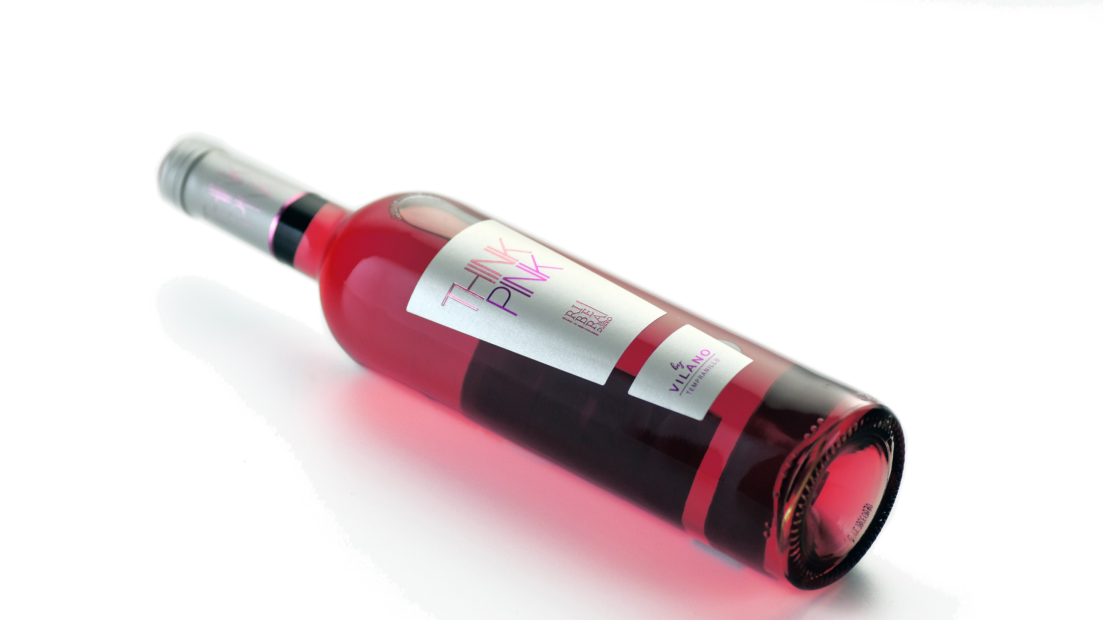

Slide 24
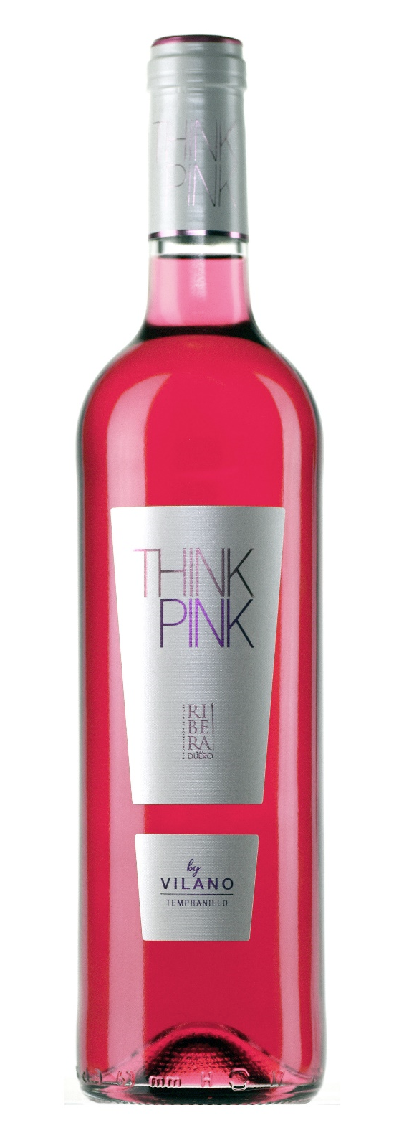
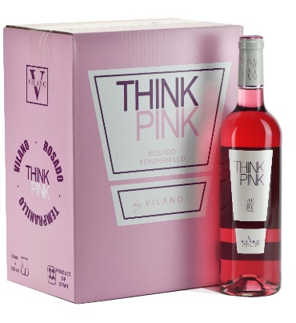
THINK PINK ROSÉ
AWARDS & RATINGS
VINTAGE 2020
Silver Medal, Gilbert & Gaillard
VINTAGE 2017
Gold Medal, Prague Wine Trophy
VINTAGE 2016
Gold Medal, Vinos Favoritos de la Mujer
VINTAGE 2014
Gold Medal, Prague Wine Trophy
VINTAGE 2011 Y 2012
Best Rosé in the World
Weinwirtschaft Magazine
VINTAGE 2021
GRAPE VARIETY: 100% Tempranillo
WINEMAKING: Finely crafted from red grapes of Tempranillo vineyards older than 40 years, the whole clusters are macerated in cold followed by gentle and short direct pressing, thereby obtaining a very pale juice.
TASTING NOTES: Delicate pink color. Deep aromas of honeysuckle, raspberries and cherries at full ripening. Fresh, medium-bodied and lingering with lively finish.
SERVING TEMPERATURE: 9º - 12ºC.
STANDARD PACKAGING
Bottle of 75cl
Cartons of 6 bottles.
125 cartons per Euro pallet

Slide 25
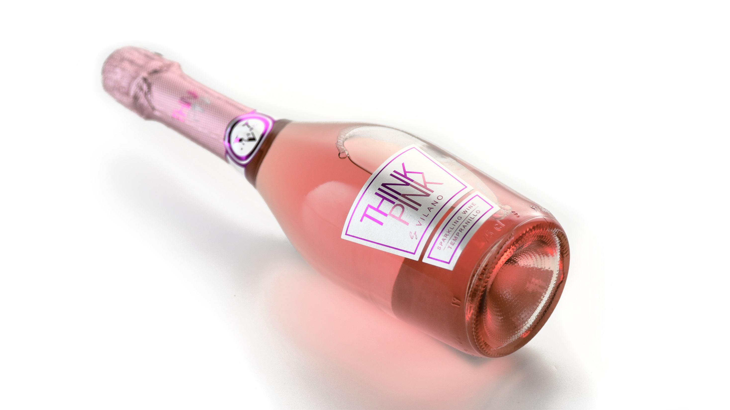

Slide 26
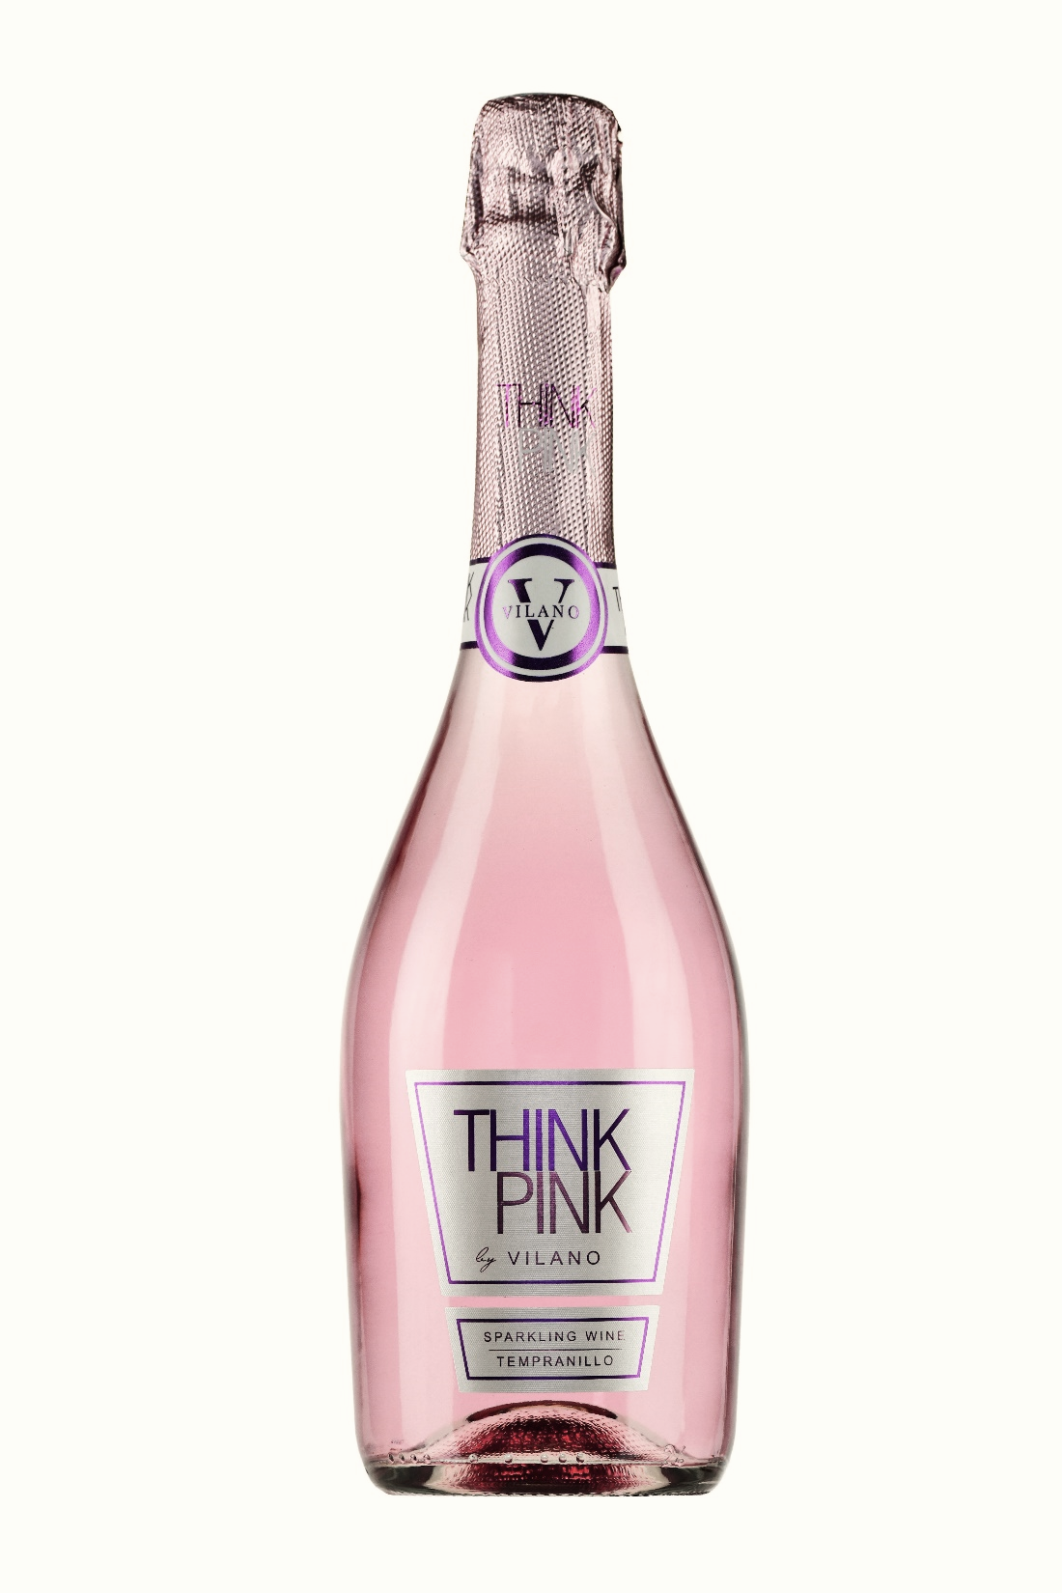
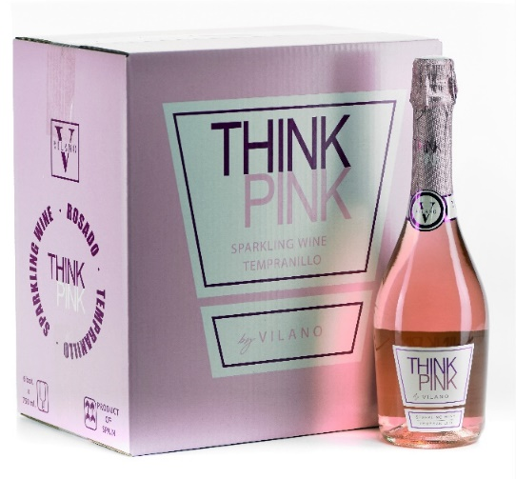
THINK PINK SPARKLING
AWARDS & RATINGS
VINTAGE 2020
Gold Medal, Women´s Wine & Spirits Awards.
GRAPE VARIETY: 100% Tempranillo
WINE CONCEPT: It´s a sweet sparkling wine made using a traditional method which stops the fermentation at 7ºC. It does not contain added sugars.
WINEMAKING: finely crafted from red grapes of Tempranillo vineyards older than 40 years, the whole clusters are macerated in cold followed by gentle and short direct pressing, thereby obtaining a very pale juice.
TASTING NOTES: delicate pink color. Deep aromas of honeysuckle, raspberries and cherries at full ripening. Fresh, medium-bodied and lingering with lively finish.
SERVING TEMPERATURE: Very cold (7-9º C)
STANDARD PACKAGING
Bottle of 75cl
Cartons of 6 bottles.
80 cartons per Euro pallet

Slide 27
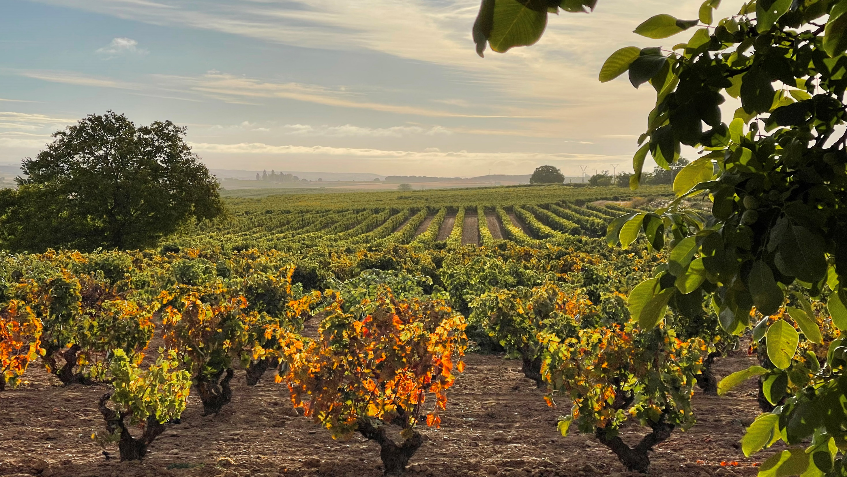

Slide 28
B O D E G A S V I L A N O
Avda. Tinta del País, 2. 09314 Pedrosa de Duero. (Burgos) Spain
Phone.+34947530029 www.vilano.com
info@vilano.com

